Slide 1

Comparison of Transmission Losses of an acoustic channel model for direct and multipath models in Deep water.
TEAM MEMBERS
19PA1A04E7 |  | SK. ABDUL KAREEM
19PA1A04F4 |  | T.G.N. VAMSI KRISHNA
19PA1A04G4 |  | U. HARSHA KUMAR
19PA1AO4D7 |  | T. PRAKASH BABU
19PA1A04H9 |  | Y.S.V.S.JASWANTH
Under the Esteemed Guidance of
MS. V. PRAVEENA
Assistant professor , ECE Dept.
Department of Electronics and communication engineering
VISHNU INSTITUTE OF TECHNOLOGY(A), BHIMAVARAM
(Approved by AICTE, Permanently affiliated to JNTUK,Approved byNBA &NAAC)

Slide 2
Overview
Introduction
Objective
Literature Review
Methodology
Simulation Parameters
Expected Outcome
References

Slide 3
Introduction
UWSN is self-organizing network
A loose collection of independent mobile nodes deployed underwater
With arbitrary topology (Due to Mobility Flexible Network)
communicates through acoustic, optical links and EM
Single-hop/multi-hop communication
Preferred acoustics ( speed, power loss, antenna size, range of propagation etc.)
Influenced by (Absorption, Geometric expansion, Doppler spread, Scattering, Multipath, Underwater Environment (depth, temperature, salinity, pH))

Slide 4
Objective:
To Compare the Transmission Losses of an acoustic channel model for direct and multipath models in Deep water and analyzing the channel characteristics at various network scenarios and environmental conditions.

Slide 5
Literature Review
The literature available from last three decades, extensively described the research challenges of UWSNs due to its unpredictable environmental conditions.
Numerous authors have worked on the basic fundamentals of UWSNs; deployment strategies; connectivity issues; architectural issues; routing protocols; energy; throughput; security; clustering; localization algorithms; and channel modeling etc.
Even though, the research is predominant in UWSNs from last two decades, but the research directions are still open for researches in the areas of security, localization, reliability aspects due to their physical and networking constraints.

Slide 6
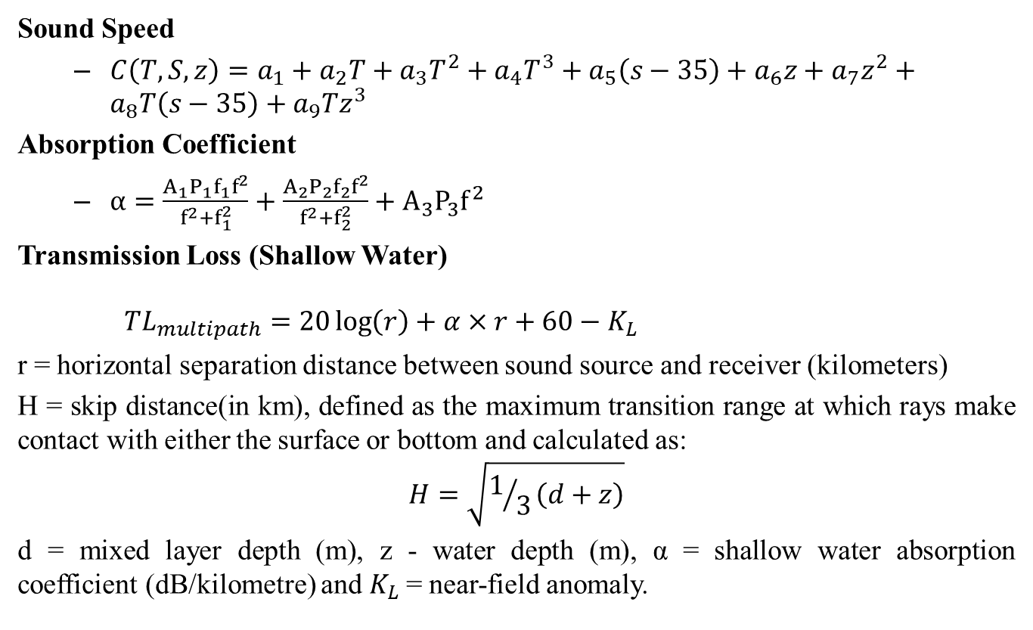
Methodology
Sound Speed
$C\left(T,S,z\right)=a_{1}+a_{2}T+a_{3}T^{2}+a_{4}T^{3}+a_{5}\left(s−35\right)+a_{6}z+a_{7}z^{2}+a_{8}T\left(s−35\right)+a_{9}Tz^{3}$
Absorption Coefficient
$α=\frac{A_{1}P_{1}f_{1}f^{2}}{f^{2}+f_{1}^{2}}+\frac{A_{2}P_{2}f_{2}f^{2}}{f^{2}+f_{2}^{2}}+A_{3}P_{3}f^{2}$
Transmission Loss (Shallow Water)
${TL}_{multipath}=20\log\left(r\right)+α×r+60−K_{L}$
r = horizontal separation distance between sound source and receiver (kilometers)
H = skip distance(in km), defined as the maximum transition range at which rays make contact with either the surface or bottom and calculated as:
$$H=\sqrt{1/3\left(d+z\right)}$$
d = mixed layer depth (m), z - water depth (m), α = shallow water absorption coefficient (dB/kilometre) and $K_{L}$= near-field anomaly.

Slide 7
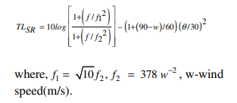

Contd…
Transmission Loss (Multipath model in deep water) due to surface reflections.

Slide 8
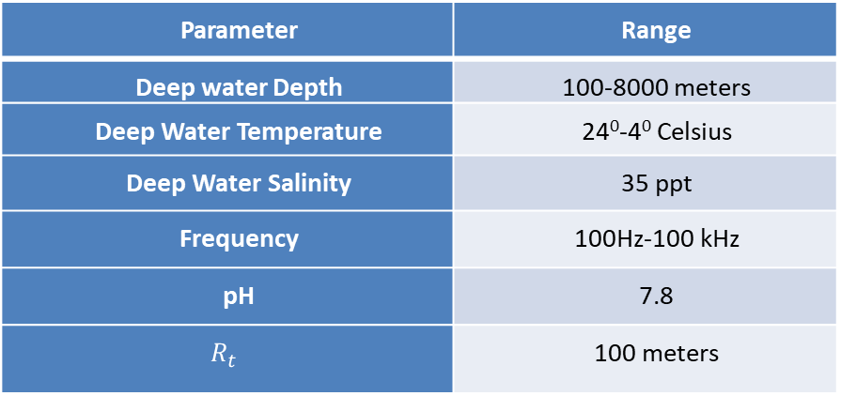
Simulation Parameters
Parameter | Range
Deep water Depth | 100-8000 meters
Deep Water Temperature | 24⁰-4⁰ Celsius
Deep Water Salinity | 35 ppt
Frequency | 100Hz-100 kHz
pH | 7.8
$$R_{t}$$ | 100 meters

Slide 9
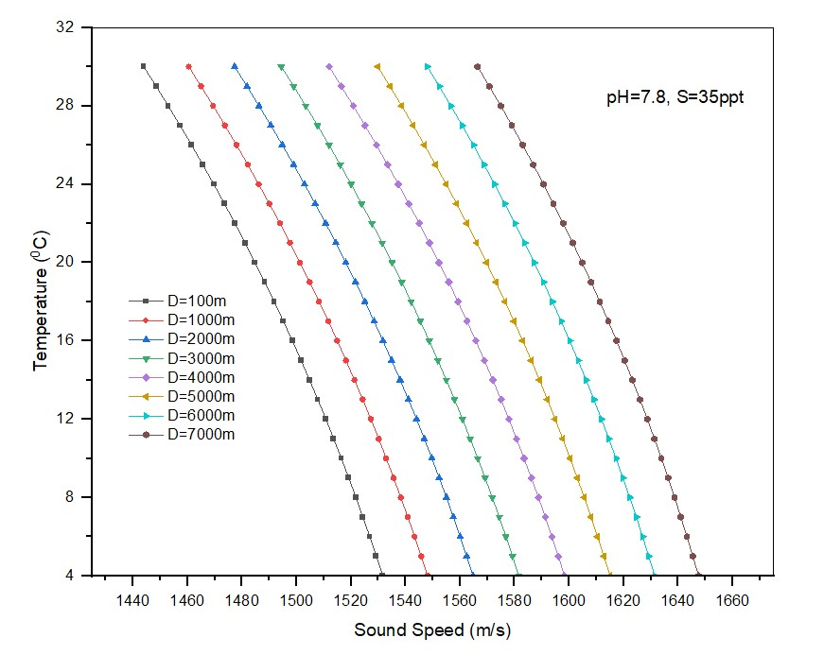
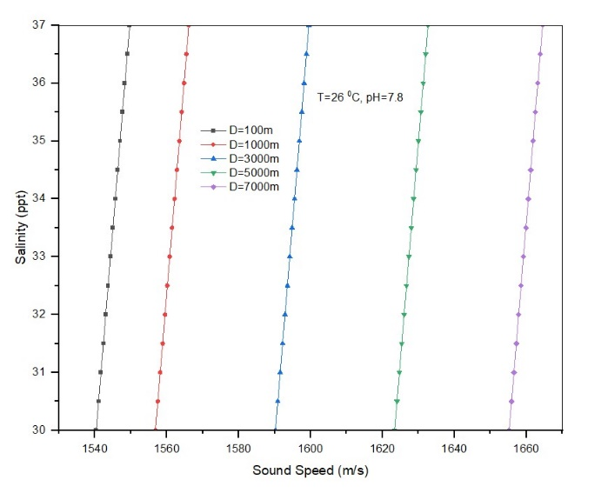
Result
Effect of salinity and Temperature variations on sound speed in deep-water
Notes:
Frequency Vs Transmission Loss at various Depths in Shallow Water
Frequency Vs Transmission Loss at Various Temperatures in Shallow Water
Frequency Vs Transmission Loss at Various Salinity in Shallow Water
Absorption Loss

Slide 10
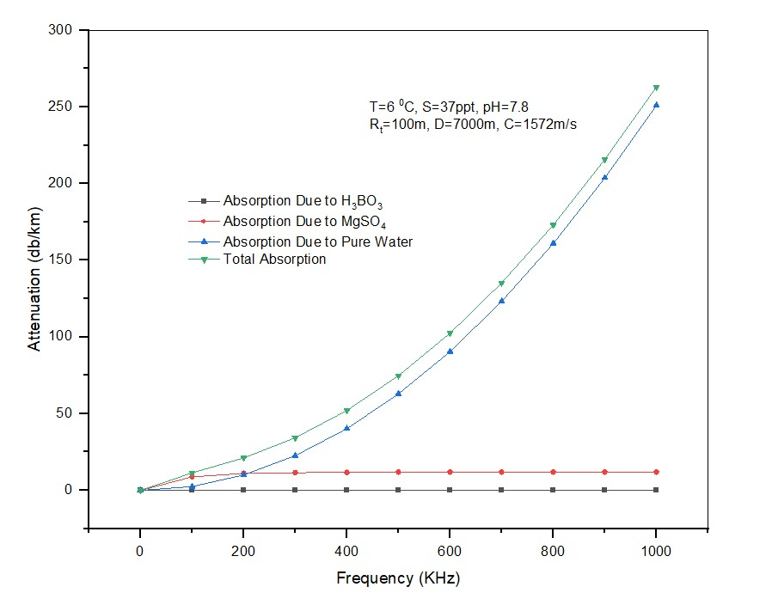
Contd…
Attenuation in deep water due to absorption

Slide 11
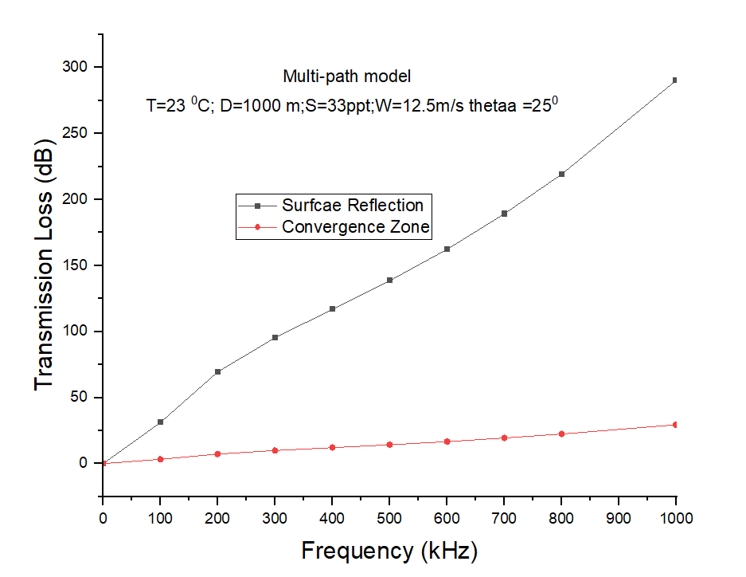
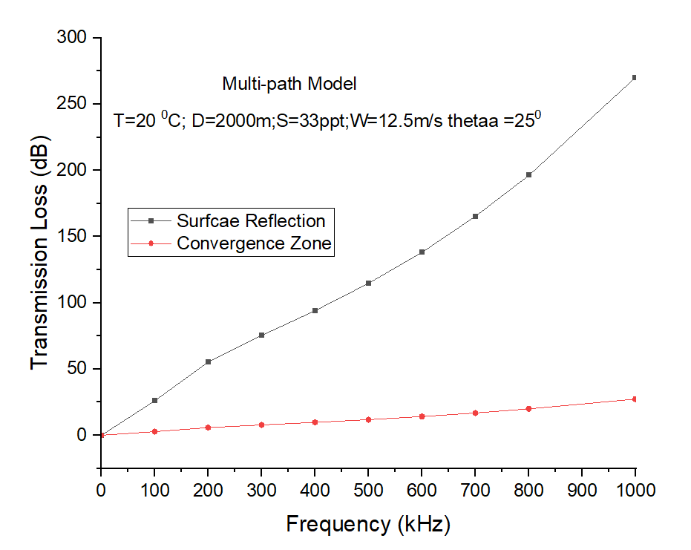
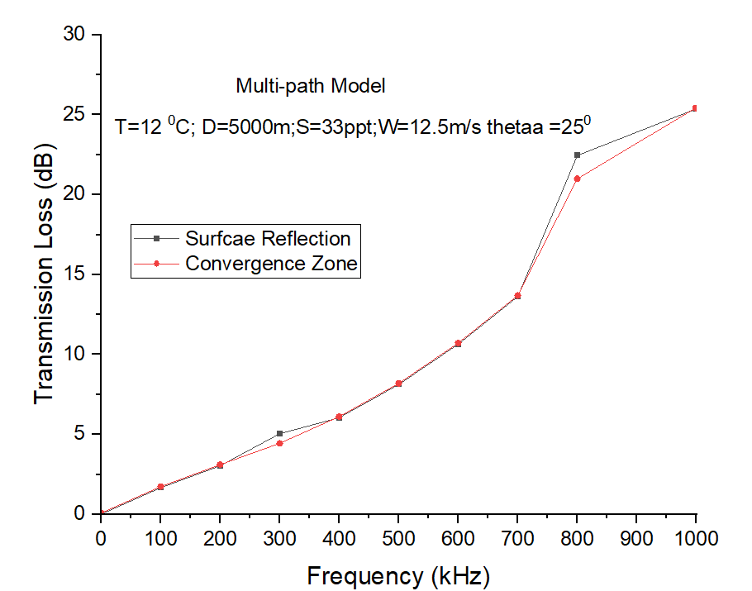
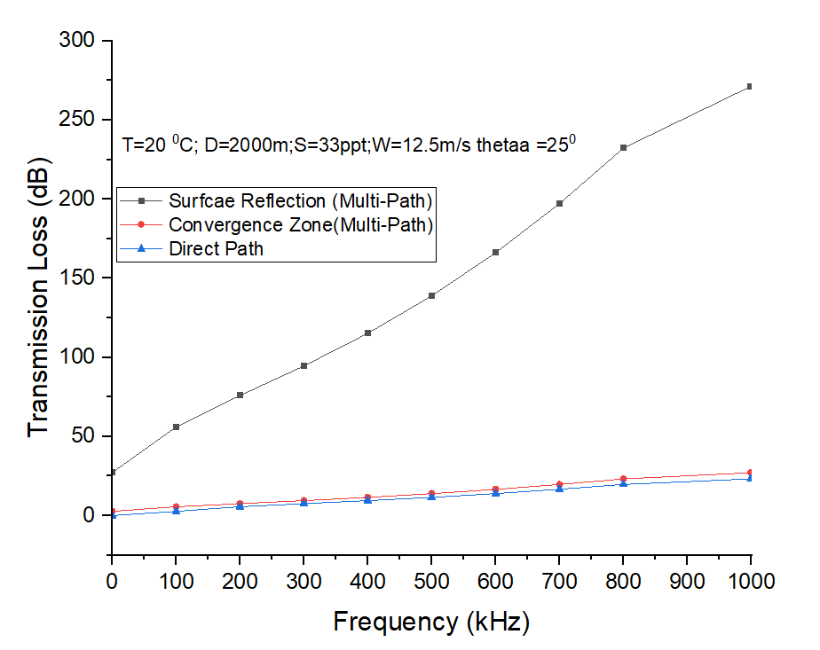
Contd…

Slide 12
References
C. V. Rao, N. Padmavathy, and S. K. Chaturvedi, Reliability evaluation of mobile ad hoc networks: with and without interference, IEEE 7th International Advance Computing Conference, pp. 233-238, 2017.
N. Padmavathy, Sanjay K. Chaturvedi, Evaluation of Mobile Ad Hoc Network Reliability Using Propagation-based Link Reliability Model, Reliability Engineering and System Safety, 115, PP.1-9, 2013.
Praveena Vardhanapu, Pushpa Kotipalli, and Adi Surendra Mohanraju.M, Frame Boundary Detection and Deep Learning based Doppler Shift Estimation for FBMC/OQAM Communication System in Underwater Acoustic Channels

Slide 13
THANK YOU
Notes:
QUESTIONS?

